Slide 1
Week 09 class 2: text analysis
INST408C: Cognitive Security | Fall 2021 | SJ Terp

Slide 2
INST408C Week
Monday
Artifact features
Wednesday
Artifact analysis
Readings
Assignments
Notes:
Links:

Slide 3
Corrections from last class
Reading json arrays can be a pain. I wrote library clean_twitter.py so you don’t have to wrestle with “df = pd.DataFrame([tweetdata]).transpose().reset_index()”
Spacy run error: fix (“python =m spacy download en” from the terminal window) is at https://stackoverflow.com/questions/54334304/spacy-cant-find-model-en-core-web-sm-on-windows-10-and-python-3-5-3-anacon

Slide 4
Not doing it yourself
Other toolsets

Slide 5
More tools
https://wiki.digitalmethods.net/Dmi/ToolDatabase
https://firstdraftnews.org/long-form-article/digitalrecipes/
https://firstdraftnews.org/long-form-article/climate-change-memes-misinformation/
https://firstdraftnews.org/articles/anti-pfizer-vaccine-narratives/

Slide 6
First Draft example: cross-platform spread
https://firstdraftnews.org/long-form-article/tracking-cross-platform-spread/
Notes:
https://firstdraftnews.org/long-form-article/climate-change-memes-misinformation/

Slide 7
Clustering and Classifying
No labels, no problem

Slide 8
Topic detection using Latent Dirichlet Analysis
no_features = 1000
no_topics = 7
tfidf_vectorizer = TfidfVectorizer(max_df=0.95, min_df=2, max_features=no_features, stop_words=stop_words)
tfidf = tfidf_vectorizer.fit_transform(dftweets['text'])
tfidf_feature_names = tfidf_vectorizer.get_feature_names()
lda = LatentDirichletAllocation(n_components=no_topics, max_iter=5, learning_method='online', learning_offset=50.,random_state=0).fit(tfidf)
no_top_words = 10
for topic_idx, topic in enumerate(lda.components_):
print("Topic %d:{}".format(topic_idx))
print(" ".join([feature_names[i]
for i in topic.argsort()[:-no_top_words - 1:-1]]))
from https://blog.mlreview.com/topic-modeling-with-scikit-learn-e80d33668730

Slide 9
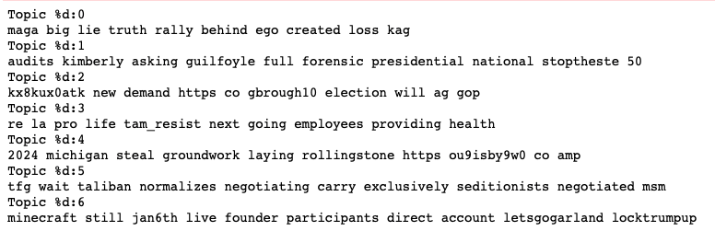
LDA topic groups

Slide 10
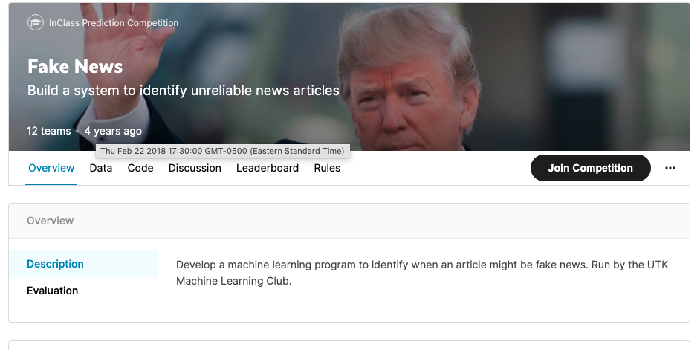
Fake news labelling using classifiers
Notes:
Kaggle’s fake news dataset https://www.kaggle.com/c/fake-news

Slide 11
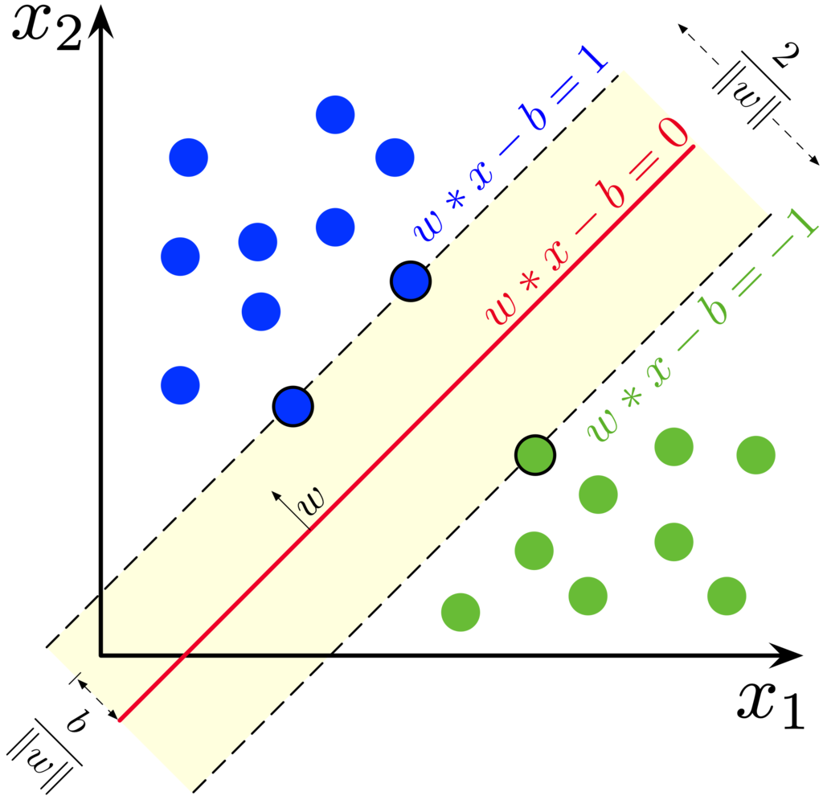
Many support vector machines later…

Slide 12
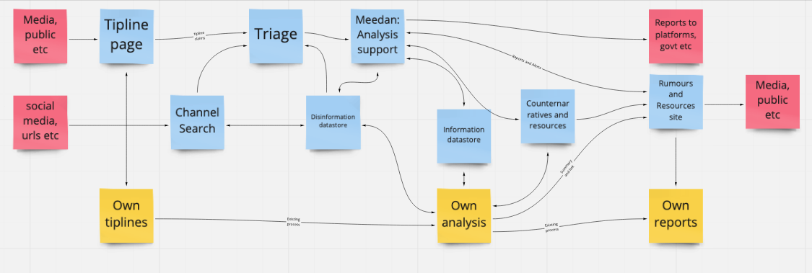
Where you really want the machine learning

Slide 13
Non-text data
Images, accounts, groups, domains etc

Slide 14
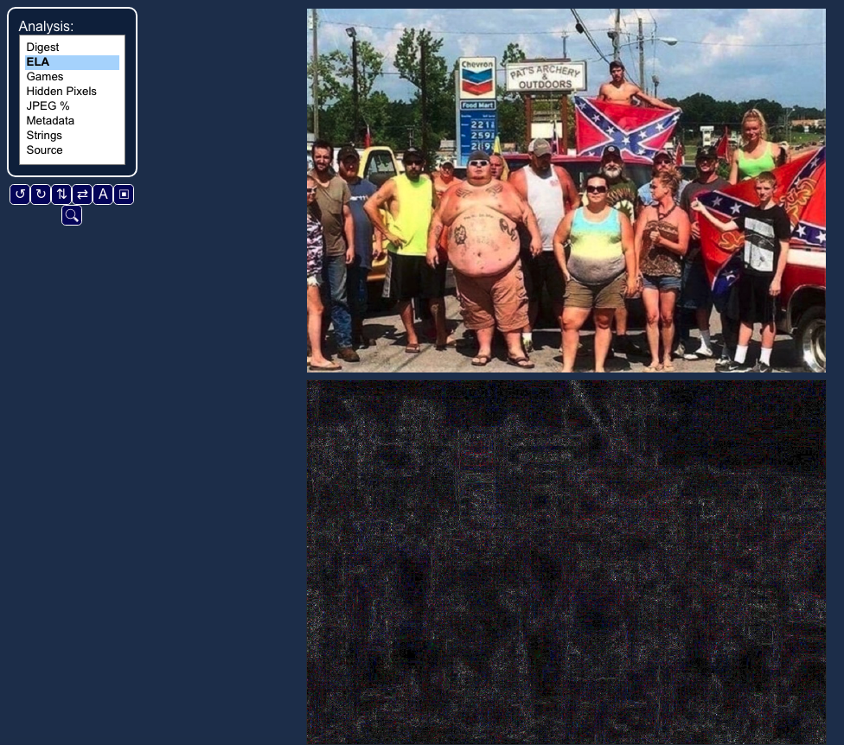
Images: doctoring, origins
Notes:
Fotoforensics.com

Slide 15
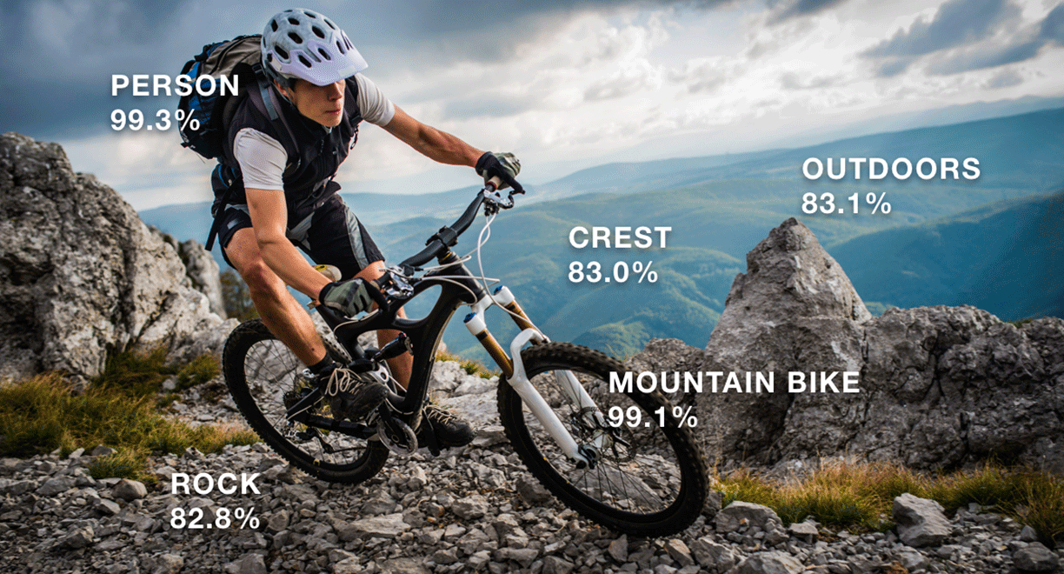
Images: object detection
https://docs.aws.amazon.com/rekognition
Notes:
https://aws.amazon.com/rekognition/ - also recognises individuals

Slide 16
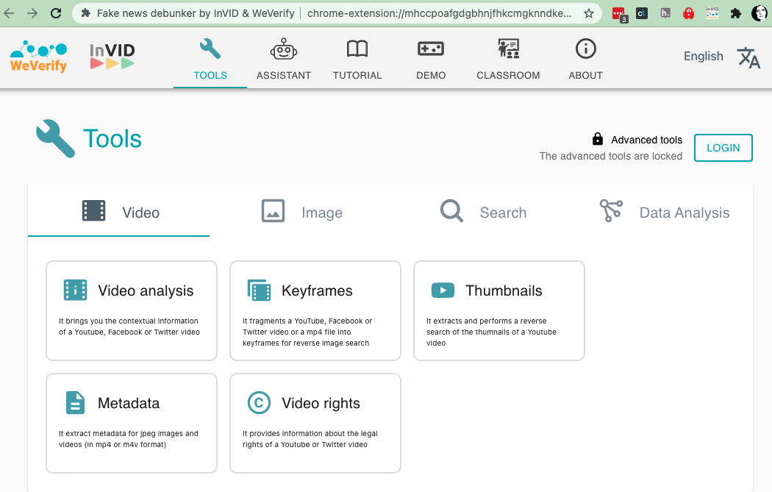
Videos: keyframes, thumbnails, logos
Notes:
https://www.invid-project.eu/

Slide 17
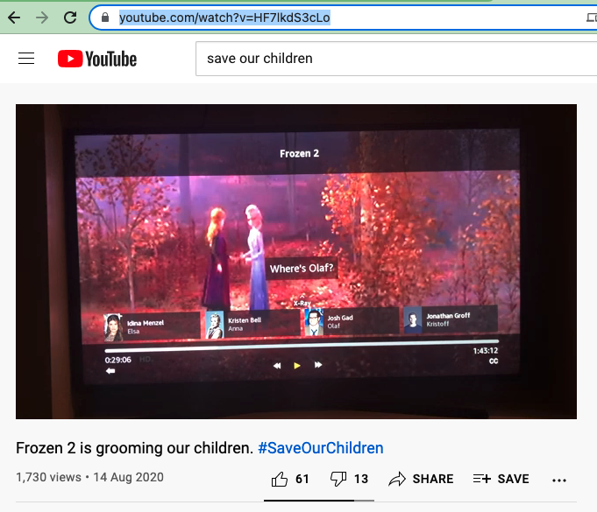
Videos: invid analysis
Notes:
https://www.youtube.com/watch?v=HF7lkdS3cLo

Slide 18
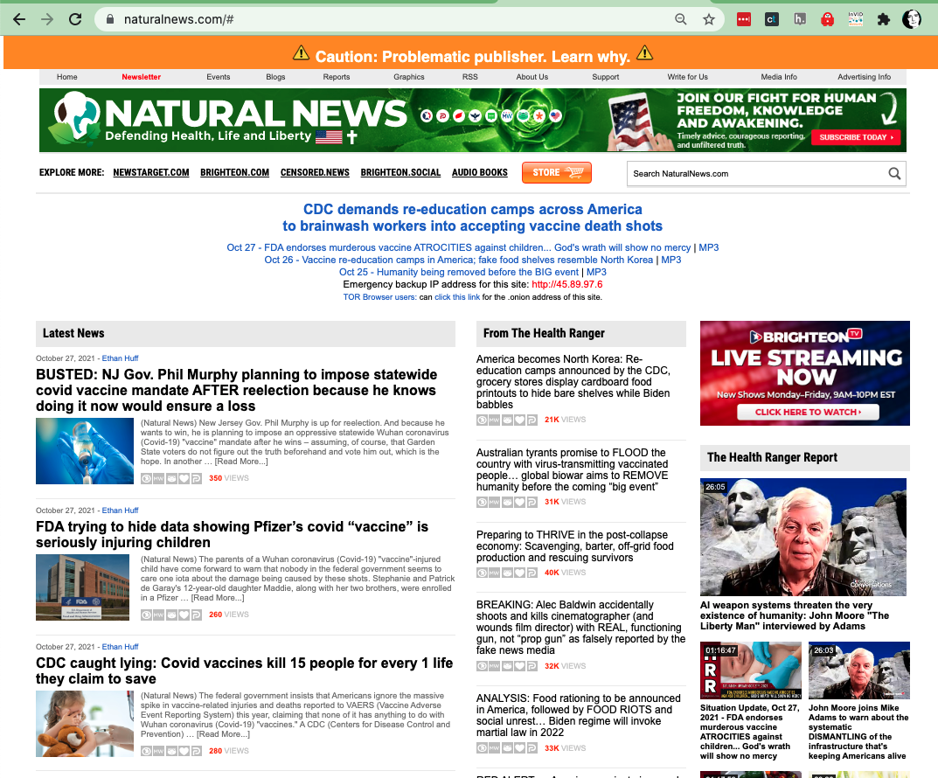
Domains

Slide 19
Domains
Getting data:
Use BeautifulSoup to parse text
Use archives (commoncrawl etc) if they have this domain’s text
Use tags (advertising etc), website mentions, and social media mentions, to map the network of connected domains
Example: https://www.cjr.org/tow_center_reports/hundreds-of-pink-slime-local-news-outlets-are-distributing-algorithmic-stories-conservative-talking-points.php
Notes:
http://overcognition.com/2020/01/22/data-safari-rough-notes-pink-slime-network/

